Slide 1

Multi-component Systems - Phase diagrams
Bernie Tao

Slide 2
Learning Objectives
Be able to use the phase rule to calculate the number of parameters needed to fully characterize/specify a system
Understand basic principles of reading multiphase, multicomponent phase diagrams
Be able to recognize and read composition, temperature and pressure values on binary, multiphase P-x and T-x diagrams
Understand what an azeotrope is

Slide 3
Phase Rule
Recall the Gibbs phase rule, F=C-P+2.
This tells us the number of intensive state parameters needed to completely specify a multiphase, multicomponent system.
It is important to have this knowledge, due to the often complex nature of these systems.
For example, in a binary liquid-vapor equilibrium mixture of water and ethanol, how many variables must be known to completely specify the system?
F = 2+2-2=2
So if we know P and T, everything else (composition) is fixed.

Slide 4
Phase Rule - example
How many intensive properties are needed to completely characterize a system at equilibrium that contains liquid water, water vapor, and ice (solid water)?
The Gibbs phase rule states F=C-P+2. The number of chemical components is 1, the number of phases is 3, so
F = 1 - 3 + 2 = 0
So there is only one set of conditions that meet these constraints and no intensive variables can be independently selected. In this simple example, this is at the triple point of water.

Slide 5
Phase Rule - example
How many intensive properties are needed to completely characterize a system at equilibrium that contains liquid water, liquid oil and nitrogen gas? (assume oil is a single chemical component)
The Gibbs phase rule states F=C-P+2. The number of chemical components is 3, the number of phases is 3, so
F = 3 - 3 + 2 = 2
So it is possible to independently select 2 intensive variables, for example P and T, or 2 compositions, before the system is completely specified.

Slide 6
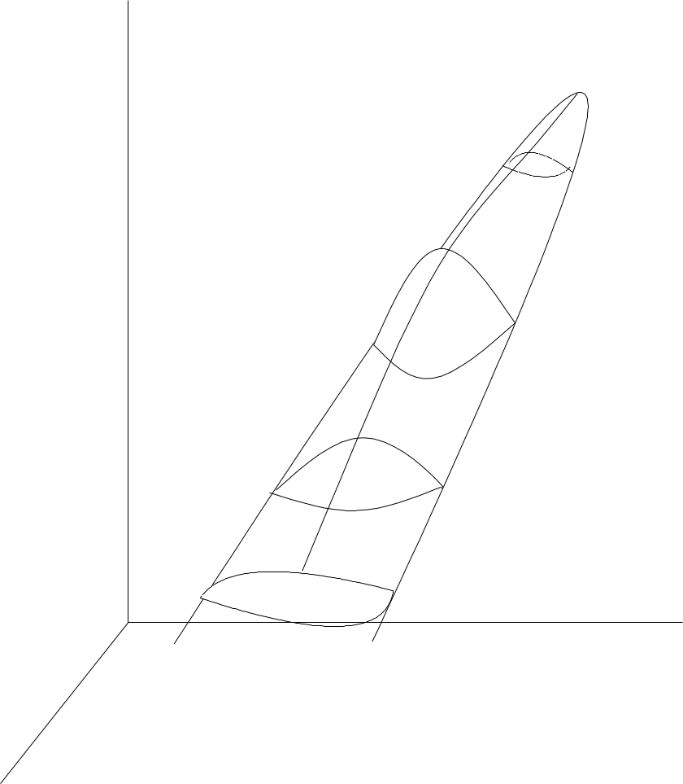
Binary phase diagrams
The addition of composition lends additional dimensions to phase diagrams.
At the right is a phase diagram envelope in P-T-X space for a binary mixture.
The volume enclosed is called the phase envelope. It defines the region where 2 phases can co-exist at equilibrium.
2-Dimensional planes of phase diagrams are somewhat easier to visualize.
Temp.
T-X plane at fixed P
P-X plane at fixed T
Composition
Pressure

Slide 7
2-D Planes of phase diagrams
T
vapor
T
Temp.
L-V 2 phase region
T-X plane at fixed P
liquid
0
X
1
P
liquid
P-X plane at fixed T
L-V 2 phase region
vapor
Composition
0
X
1
Pressure

Slide 8

T-x binary phase diagrams
T
This temperature is the boiling point of pure component A.
This is a 2 phase diagram
at constant pressure in T-x space.
The vertical axis represents temperature
The horizontal axis represents the binary composition of components A and B.
Their composition is oppositely directed, i.e. at x_{A} = 1, x_{B}=0.
For the sake of convenience, the composition is only given for 1 component.
This temperature is the boiling point of pure component B.
x_{A} =0
x_{A}
x_{A}=1

Slide 9
T-X Phase diagrams
T
This is a 2 phase diagram
at constant pressure in T-x space.
This region is 100 % vapor phase
The upper curve is called the dew point curve, since it describes the conditions where the first droplets of liquid form.
The curves that define
the 2 phase region are
called the phase
envelope.
This is the 2 phase region, where liquid and vapor co-exist.
The lower curve is called the bubble line since it describes the conditions where the first bubbles of vapor form.
This region is 100% liquid phase
0
X
1

Slide 10
T-X Phase diagrams
T
vapor
T1
1
This point represents a 2 phase equilibrium mixture
1
at temperature T1
with an overall composition of X_{m}
2 phase region
liquid
0
X
X_{m}

Slide 11
T-X Phase diagrams
vapor
liquid
T
In reality, this mixture is composed of 2 phases.
T1
1V
1
1L
A saturated vapor phase.
1V
with composition X_{1V}
2 phase region
A saturated liquid phase
with composition X_{1L}
1L
Note that more of the mass is in the liquid phase than the vapor phase.
liquid
0
X_{1V}
X
X_{m}
X_{1L}

Slide 12
Phase diagrams
T
If the temperature of the mixture is decreased to T₂, the composition of the overall mixture remains the same.
1V
1
1L
T₂
2L
T2
2V
2
However the composition of each of the 2 phases that make up the mixture change.
The liquid composition shifts to X_{2L}
2L
The vapor ompositions shifts to X_{2V}
2V
0
X_{2V}
X_{m}
X_{2L}
1

Slide 13
Phase diagrams
vapor
liquid
T
1V
1
1L
Note that the amounts of each phase also change.
At the lower temperature, more liquid is present.
T2
2V
2
2L
vapor
liquid
0
X_{m}
1

Slide 14
The relationship between the amount and composition of each phase versus the overall mixture composition is:
N_{m}*x_{m} = N_{V}*x_{V} + N_{L}*x_{L}
N_{m}- total moles of mixture
x_{m} - mole frac. of component i in mixture
N_{V} - moles of vapor
x_{V} - mole frac. of component i in vapor
N_{L} - moles of liquid
x_{L -} mole frac. of component i in liquid
T
2V
2
2L
0
X_{V}
X_{m}
X_{L}
1

Slide 15
Since there are 2 components (A, B), 2 equations can be written,
N_{m}*x_{mA} = N_{V}*x_{VA} + N_{L}*x_{LA}
N_{m}*x_{mB} = N_{V}*x_{VB} + N_{L}*x_{LB}
These are essentially material balances on the mixture, so they can be used to solve for 2 unknown quantities, for example N_{L} and N_{V}.

Slide 16
Example - L-V mixture calculation
A 2-phase mixture contains 50% A (x_{mA}) and 50% B (x_{mB}) with a total of 100 moles (N_{m}). The saturated liquid has a composition of 80% A (x_{LA}) and the saturated vapor has a composition of 35% A (x_{VA}). How many moles of each phase are in the mixture?
N_{m}*x_{mA} = N_{V}* x_{VA} + N_{L}*x_{LA} -> 100*0.5 = N_{V}*0.35 + N_{L}*0.80
N_{m}*x_{mB} = N_{V}*x_{VB} + N_{L}*x_{LB} -> 100*0.5 = N_{V}*0.65 + N_{L}*0.20
Re-arranging,
50 = 0.35 N_{V} + 0.80 N_{L}
50 = 0.65 N_{V} + 0.20 N_{L}
Solving, N_{L} = 33.33 and N_{V} =66.67
So the mixture is composed of 33.33 moles of liquid and 66.67 moles of vapor.

Slide 17
P-x binary phase diagrams
The vertical axis represents pressure
P
This pressure is the vapor pressure of pure component B at temperature T.
This is a 2 phase diagram
at constant temperature T in P-x space.
This pressure is the vapor pressure of pure component A at temperature T.
x_{A} =0
x_{A}
x_{A}=1

Slide 18
P-x binary phase diagrams
P
This diagram is similar to the T-x diagram, only pressure is the vertical axis.
The composition of a 2-phase mixture is the sum of the 2 saturated phases.
If the pressure is changed, the saturated phases shift in both amount and composition.
x_{A} =0
x_{A}
x_{A}=1

Slide 19
Azeotropes
On a mono-variant phase diagram, the liquid and vapor compositions are always different with the exception of pure components.
In real systems, intermediate compositions exist in which the vapor and liquid equilibrium compositions are identical, i.e. x₁ = y₁ and x₂= y₂.
A mixture composition that exhibits this behavior is called an azeotrope.

Slide 20
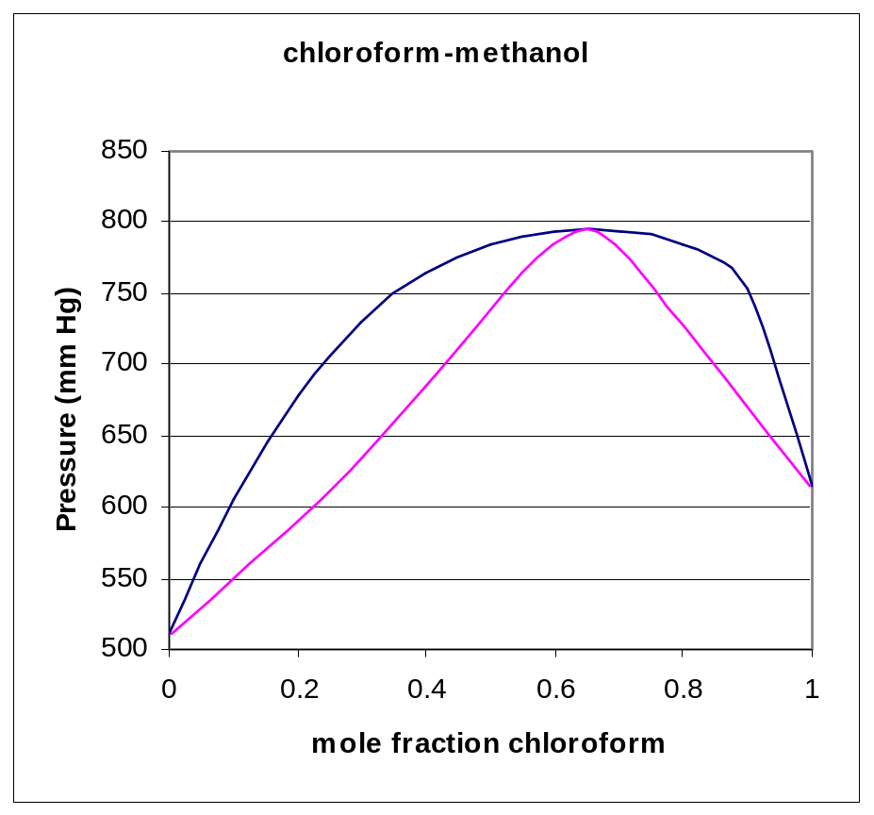
This is the phase diagram for
a binary mixture of chloroform
and methanol at 53 ºC.
Note the azeotrope at approx.
65 mol % chloroform.
At this composition, the
components cannot be separated
by distillation or condensation,
since the liquid will have the
same composition as the vapor.
When the mixture vapor pressure
is greater than the pure component
vapor pressures, the mixture boils
at a lower temperature than either
of the pure components. This is
called a minimum boiling azeotrope.

Slide 21
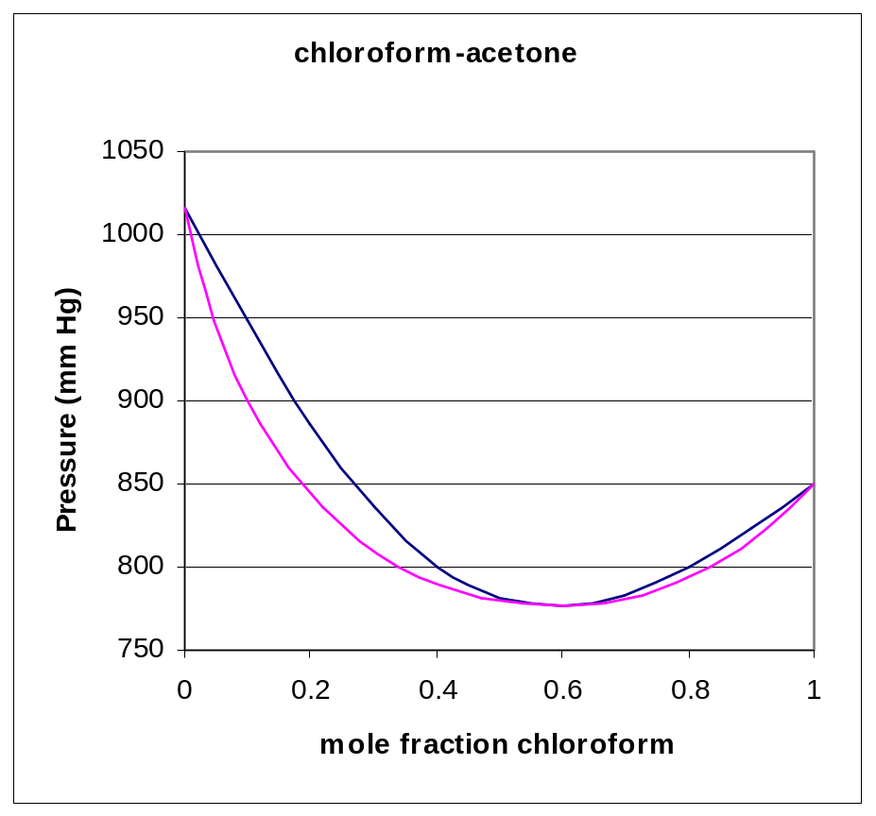
This is the phase diagram for
a binary mixture of chloroform
and acetone at 65 ºC. Note the azeotrope at approx. 60 mol% chloroform.
When the mixture vapor pressure is less than the pure component vapor pressures, the mixture boils at a higher temperature than either
of the pure components. This is called a maximum boiling azeotrope.

